Slide 1
ECE 411 Spring 2016 Lecture 5
Cache Memories

Slide 2

Watch this
Click the chip

Slide 3
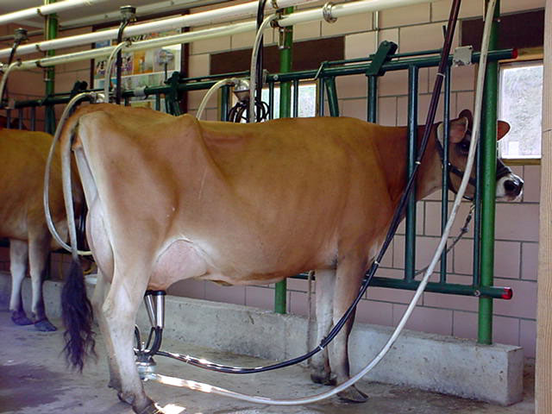

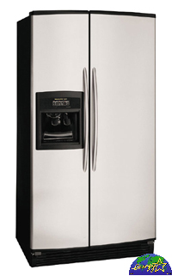
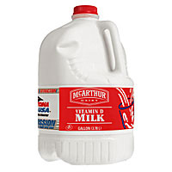
Model of Memory Hierarchy
Increasing Speed
SRAM
Physical Memory
DRAM
Virtual Memory
DISK
Reg
File
L1
Data cache
L2
Cache
Main
Memory
L1
Inst cache
Increasing Capacity

Slide 4
Example of Locality
int A[100], B[100], C[100], D;
for (i=0; i<100; i++) {
C[i] = A[i] * B[i] + D;
}
D
C[99]
C[98]
C[97]
C[96]
. . . . . . . . . . . . . .
C[7]
C[6]
C[5]
C[4]
C[3]
C[2]
C[1]
C[0]
. . . . . . . . . . . . . .
B[11]
B[10]
B[9]
B[8]
B[7]
B[6]
B[5]
B[4]
B[3]
B[2]
B[1]
B[0]
A[99]
A[98]
A[97]
A[96]
. . . . . . . . . . . . . .
A[7]
A[6]
A[5]
A[4]
A[3]
A[2]
A[1]
A[0]
A Cache Line (One fetch)

Slide 5
Modern Memory Hierarchy
By taking advantage of the principle of locality:
Present the user with as much memory as is available in the cheapest technology
Provide access at the speed offered by the fastest technology
Processor
Control
Secondary
Storage
(Disk)
Third
Level
Cache
(SRAM)
Tertiary
Storage
(Disk/Tape)
Main
Memory
(DRAM)
L1 I
Cache
Second
Level
Cache
(SRAM)
Datapath
Registers
L1 D
Cache

Slide 6
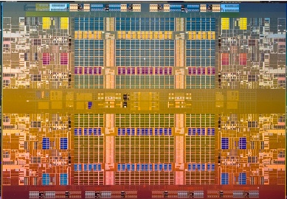
Intel Nehalem
3MB
3MB
Core 0
Core 0
3MB
3MB
Core 1
3MB
3MB
3MB
3MB
24MB L3

Slide 7
Cache Terminology
Hit: data appears in some block
Hit Rate: the fraction of accesses found in the level
Hit Time: Time to access the level (consists of RAM access time + time to determine hit)
Miss: data needs to be retrieved from a block in the lower level (e.g., Block Y)
Miss Rate = 1 - (Hit Rate)
Miss Penalty: time to replace a block in the upper level + time to deliver the block to the processor
Hit Time << Miss Penalty

Slide 8
Basic Cache Operation
Lower Level
Memory
Upper Level
Memory
From Processor
Blk X
Blk Y
To Processor

Slide 9
Average Memory Access Time
Average memory-access time = Hit time + Miss rate x Miss penalty
Miss penalty: time to fetch a block from lower memory level
access time: function of latency
transfer time: function of bandwidth b/w levels
Transfer one “cache line/block” at a time
Transfer at the size of the memory-bus width

Slide 10
Memory Hierarchy Performance
Average Memory Access Time (AMAT)
= Hit Time + Miss rate * Miss Penalty
= T_{hit}(L1) + Miss%(L1) * T(memory)
Example:
Cache Hit = 1 cycle
Miss rate = 10% = 0.1
Miss penalty = 300 cycles
AMAT = 1 + 0.1 * 300 = 31 cycles
Can we improve it?
1 clk
300 clks
Main
Memory
(DRAM)
$
Miss % * Miss penalty
Hit Time

Slide 11
Reducing Penalty: Multi-Level Cache
Average Memory Access Time (AMAT)
= T_{hit}(L1) + Miss%(L1)* (T_{hit}(L2) + Miss%(L2)* (T_{hit}(L3) + Miss%(L3)*T(memory) ) )
= T_{hit}(L1) + Miss%(L1)* T_{miss}(L1)
= T_{hit}(L1) + Miss%(L1)* {T_{hit}(L2) + Miss%(L2)* (T_{miss}(L2) }
= T_{hit}(L1) + Miss%(L1)* {T_{hit}(L2) + Miss%(L2)* (T_{miss}(L2) }
= T_{hit}(L1) + Miss%(L1)* {T_{hit}(L2) + Miss%(L2) * [ T_{hit}(L3) + Miss%(L3) * T(memory) ] }
1 clk
10 clks
20 clks
300 clks
Main
Memory
(DRAM)
L1
L2
On-die
L3

Slide 12
AMAT Example
= T_{hit}(L1) + Miss%(L1)* (T_{hit}(L2) + Miss%(L2)* (T_{hit}(L3) + Miss%(L3)*T(memory) ) )
Example:
Miss rate L1=10%, T_{hit}(L1) = 1 cycle
Miss rate L2=5%, T_{hit}(L2) = 10 cycles
Miss rate L3=1%, T_{hit}(L3) = 20 cycles
T(memory) = 300 cycles
AMAT = ?
2.115 (compare to 31 with no multi-levels)
14.7x speed-up!

Slide 13
Types of Caches
Type of cache | Mapping of data from memory to cache | Complexity of searching the cache
Direct mapped (DM) | A memory value can be placed at a single corresponding location in the cache | Fast indexing mechanism
Set-associative (SA) | A memory value can be placed in any of a set of locations in the cache | Slightly more involved search mechanism
Fully-associative (FA) | A memory value can be placed in any location in the cache | Extensive hardware resources required to search (CAM)
DM and FA can be thought as special cases of SA
(e.g, DM → 1-way SA, FA → All-way SA)

Slide 14
Direct Mapping
Direct mapping:
A memory value can only be placed at a single corresponding location in the cache
Tag
Index
Data
00000
0
00000
0
0x55
0x55
0x0F
00000
0x0F
1
00000
00000
1
00001
0
11111
11111
0
0xAA
0xAA
0xF0
11111
0xF0
11111
11111
1

Slide 15
Set Associative Mapping (2-Way)
Set-associative mapping:
A memory value can be placed in any location of a set in the cache
Tag
Index
Data
Way 0
Way 1
0000 0
0x55
0
0000 0
0
0x55
0x0F
1
0000 1
0x0F
1
0000 1
0
1111 0
0
0xAA
1111 0
0xAA
0xF0
1111 1
0xF0
1
1111 1

Slide 16
Fully Associative Mapping
Fully-associative mapping:
A memory value can be placed anywhere in the cache
Tag
Data
000000
0000
0x55
000000
0x55
0000
0x55
0x55
0x0F
0x0F
0x0F
000001
0x0F
0000
000001
0000
000110
000110
111110
1111
111110
1111
0xAA
0xAA
0xAA
0xAA
0xF0
0xF0
0xF0
111111
0xF0
1111
111111
1111

Slide 17
Direct Mapped Cache
Location 0 is occupied by data from (0, 4, 8, and C)
Which one should we place in the cache?
How can we tell which one is in the cache?
0
1
Cache Index
Address
2
3
0
4
1
5
2
3
DM Cache
6
7
A Cache Line (or Block)
8
9
A
B
C
D
E
Memory
F

Slide 18
Three Cs (Cache Miss Terms)
Compulsory Misses:
Cold start misses (caches do not have valid data at the start of the program)
0x1234
Processor
Cache

Slide 19
Three Cs (Cache Miss Terms)
Capacity Misses:
Increase cache size
0x1234
0x5678
0x91B1
0x1111
Processor
Cache

Slide 20
Three Cs (Cache Miss Terms)
Conflict Misses:
Increase cache size and/or associativity.
Associative caches reduce conflict misses
0x1234
0x5678
0x91B1
0x1111
Processor
Cache

Slide 21
Four Central Questions in Designing a Cache
P-I-R-W:
Placement: Where can a block of memory go?
Identification: How do I find a block of memory?
Replacement: How do I make space for new blocks?
Write Policy: How do I propagate changes?
Need to consider these for all levels of the memory hierarchy
L1/L2/L3 caches now
Main memory, disks have similar issues, addressed later

Slide 22
Describing Caches: 7 Parameters
Access Time: T_{hit}
Capacity: the total amount of data the cache can hold
# of blocks * block size
Block (line) Size: the amount of data that gets moved into or out of the cache as a chunk
Analogous to page size in virtual memory
Replacement Policy: What data is replaced on a miss?
Associativity: How many locations in the cache is a given address eligible to be placed in?
Unified, Instruction, Data: What type of data is kept in the cache? We’ll cover this in more detail later

Slide 23
Example: 1KB DM Cache, 32-byte Lines
The lowest M bits are the Offset (Line Size = 2M)
Index = log2 (# of sets)
Address
31
9
4
0
Tag
Index
Offset
Ex: 0x01
Ex: 0x00
Valid Bit
Cache Tag
Cache Data
Byte 31
:
Byte 1
Byte 0
0
Byte 63
:
Byte 33
Byte 32
1
2
# of set
3
:
:
:
Byte 1023
:
Byte 992
31

Slide 24
Example of Caches
Given a 2MB, direct-mapped physical caches, line size=64bytes, and 52-bit physical address
Tag size?
Now change it to 16-way, Tag size?
How about if it’s fully associative, Tag size?

Slide 25
Example: 1KB DM Cache, 32-byte Lines
lw from 0x77FF1C68
Tag
Index
Offset
77FF1C68 = 0111 0111 1111 1111 0001 1100 0101 1000
Tag array
Data array
2
27
26
25
24

Slide 26
DM Cache Speed Advantage
Tag and data access happen in parallel
Faster cache access!
Tag
Index
Offset
Tag array
Data array
Index

Slide 27
Ass. Caches Reduce Conflict Misses
Set associative (SA) cache
multiple possible locations in a set
Fully associative (FA) cache
any location in the cache
Hardware and speed overhead
Comparators
Multiplexors
Data selection only after Hit/Miss determination (i.e., after tag comparison)

Slide 28
Set Associative Cache (2-way)
Cache index selects a “set” from the cache
The two tags in the set are compared in parallel
Data is selected based on the tag result
Additional circuitry as compared to DM caches
Makes SA caches slower to access than DM of comparable size
Cache Index
Valid
Cache Tag
Cache Data
Cache Data
Cache Tag
Valid
Cache Line 0
Cache Line 0
:
:
:
:
:
:
Adr Tag
Compare
Sel1
1
Mux
0
Sel0
Compare
OR
Cache Line
Hit

Slide 29
Set-Associative Cache (2-way)
lw from 0x77FF1C78
Tag
Index
offset
Tag array0
Data aray0
Data array1
Tag array1

Slide 30
Fully Associative Cache
tag offset
Tag
Data
=
=
=
Associative Search
=
Multiplexor
Rotate and Mask

Slide 31
Fully Associative Cache
Write Data
Tag
offset
Address
Tag
Data
Tag
Data
Tag
Data
Tag
Data
compare
compare
compare
compare
Additional circuitry as compared to DM caches
More extensive than SA caches
Makes FA caches slower to access than either DM or SA of comparable size
Read Data

Slide 32
Cache Write Policy
Write through -The value is written to both the cache line and to the lower-level memory
- Write traffic to the next level even when hit
+ next level is always up to date
+ all blocks in current level are disposable
Write back - The value is written only to the cache line. The modified cache line is written to main memory only when it has to be replaced.
+ no write traffic to the next level when hit
- next level is out of date
- dirty bit per tag is required

Slide 33
Write-through Policy
0x1234
0x1234
0x5678
0x1234
0x5678
0x1234
Processor
Cache
Memory

Slide 34
Write-back Policy
0x1234
0x1234
0x1234
0x5678
?????
0x9ABC
0x5678
0x1234
0x5678
Processor
Cache
Write miss
Memory

Slide 35
On Write Miss
Write allocate
The line is allocated on a write miss, followed by the write hit actions above.
Write misses first act like read misses
Better performance if data referenced again
No write allocate
Write misses do not interfere cache
Line is only modified in the lower level memory
Mostly use with write-through cache
Simpler write hardware
May be better for small caches if written data won’t be read again soon

Slide 36
Reducing Miss Rate
Enlarge cache
If cache size is fixed
Increase associativity and/or line size (does this always work?)
Increasing cache pollution
4
0
%
3
5
%
3
0
%
1
K
B
e
2
5
%
8
K
B
t
1
6
K
B
a
r
2
0
%
s
6
4
K
B
s
i
M
1
5
%
2
5
6
K
B
1
0
%
5
%
0
%
4
1
6
6
4
2
5
6
B
l
o
c
k
s
i
z
e
(
b
y
t
e
s
)

